Slide 1

Lecture 02,03
Mobile Cellular Network
By-
Jesmin Akhter
Associate Professor
Institute of Information Technology
Jahangirnagar University

Slide 2
Channel Allocation Scheme
Fixed Channel Allocation (FCA)
Channel Borrowing Scheme
Dynamic Channel Allocation (DCA)

Slide 3
Fixed Channel Assignment (FCA)
Permanently assign a fixed set of channels to each cell and reuse them in the co-channel cells
A user is assigned an unoccupied channel on demand, which is relinquishes after the call is over
If the number of calls exceeds the channel set for a cell, the excess calls are blocked
To maximize reuse of the available frequency channels, various graph coloring techniques have been proposed
due to short term fluctuations in the traffic, FCA schemes are often not able to maintain high quality of service and capacity attainable with static traffic demands
Does not solve “hot spot” problem
Notes:
In its simplest form, it is a way of coloring the vertices of a graph such that no two adjacent vertices share the same color; this is called a vertex coloring. Similarly, an edge coloring assigns a color to each edge so that no two adjacent edges share the same color, and a face coloring of a planar graph assigns a color to each face or region so that no two faces that share a boundary have the same color.

Slide 4

Notes:
Hotspot is a place of more than usual interest, activity, or popularity.
a place of significant activity, danger, or violence.

Slide 5
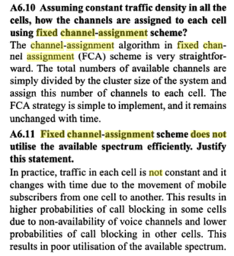
Notes:
Wireless Communications
By Singal

Slide 6
Simple Borrowing
- A channel is borrowed from a neighboring cell provided it does not interfere with existing calls
X
C
B
E
B:{b1, b2,..}
a3
A
C
B
D
G
A
a3
A:{a1, a2,…}
E
F
D
B
E
F
A
C
B
E
X
G
A
C
F
D
G
E
F
D
(a)
(b)
FCA: A-G denote different sets of channels permanently assigned to cells
Borrowing: Channel a3 is borrowed by B from A. Cells marked X are prohibited from using a3

Slide 7
Dynamic Channel Assignment (DCA)
No cell has a proprietary set of channels. Channels are allocated to a user on demand from a central pool on the basis of a cost function.
Notes:
proprietary -registered

Slide 8
Handover (Handoff)
Hand-off is the process of switching from one frequency channel to another by the user in midst of a communication. Hand-off takes place when a user crosses the cell boundary. It Provides continuity of communication across cells. Handoffs must be performed successfully and as infrequently as possible, and be imperceptible to the users.
Process
  Received signal weakens as mobile moves out of cell (Minimum usable signal level is normally set to be between -90 dBm and -100 dBm).
  A slightly save signal level is used as a threshold at which a handoff is made.
  Cell site at some point requests handover to cell with stronger signal strength.
  MSC switches call to new cell after allocating channels, and informing the two mobiles of the new channels (voice and control channels).
Notes:
The suffix after dB implies reference
dBm----Reference is milliwatt(mW)
dBῃ------ reference is microwatt
dBmV-----reference is milivolt

Slide 9
Reasons for a Handoff to be conducted
To avoid call termination: call drops
When the capacity for connecting new calls of a given cell is used up.
Interference in the channels.
When the user behaviors change.
  Speed and mobility.

Slide 10
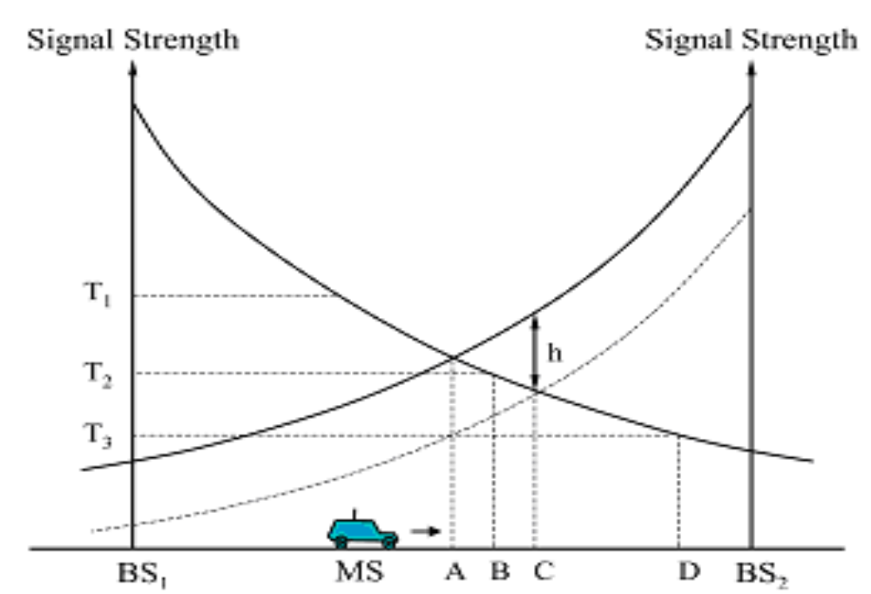
Importance of handoff decision time

Slide 11
Three parameters to initiate handoff
Received Signal Strength (RSS)
Signal-to-Noise Ratio (SNR)
Bit Error Rate (BER)
The quality of the RSS from the mobile station is monitored by the BS. When the RSS is below a certain threshold. BS instructs the mobile station to collect signal strength measurements from neighboring BSs
Case 1: mobile station sends the collected information to the BS.
BS conveys the signal information to its parent MSC (mobile switching center) which selects the most suitable next BS for the mobile station
Both the selected BS and the mobile station are informed when new BS assigns an unoccupied channel to the mobile station
Case 2: mobile station itself selects the most suitable BS.
The mobile station informs the current BS, who conveys information about the next BS to its MSC
The selected BS is informed by the MSC which assigns a new channel
Notes:
The bit error rate (BER) is the number of bit errors per unit time. It is the rate at which errors occur in the transmission of digital data.

Slide 12
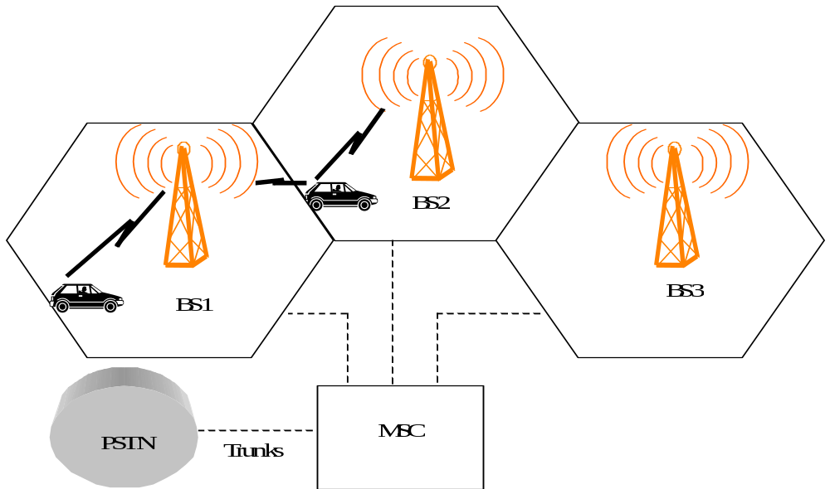
Handover Process (1)

Slide 13
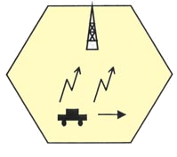
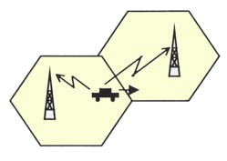
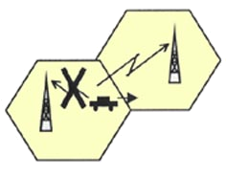
Handoff Types
Intra-Cell
Inter-Cell
Soft Handoff
Hard Handoff

Slide 14
INTER-CELL AND INTRA-CELL HANDOVER
The inter-cell handover switches a call in progress from one cell to another cell, and the intra-cell handover switches a call in progress from one physical channel of a cell to another physical channel of the same cell.

Slide 15
HARD HANDOVER
“BREAK BEFORE MAKE”
Old connection is broken before a new connection is activated
Primarily used in FDMA and TDMA systems (e.g. GSM)
Different frequency ranges used in adjacent cells to minimize the interference
A Hard handover is relatively cheaper and easier to implement in comparison to other types of Handover.
It is simpler as phone's hardware does not need to be capable of receiving two or more channels in parallel.

Slide 16

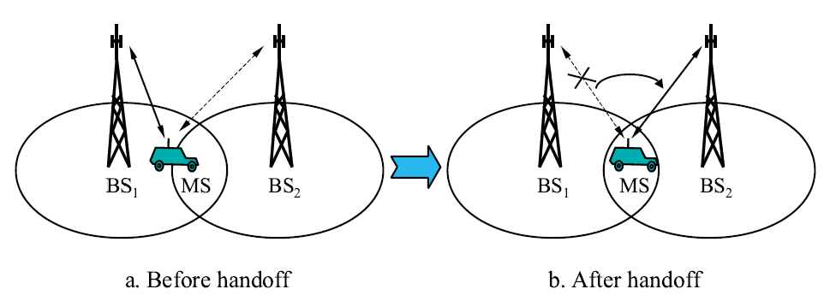
The base station BS₁ on one cell site hands off the mobile station(MS)’s call to another cell BS₂.
The link to the prior base station, BS₁ is terminated before the user is transferred to the new cell’s base station, BS₂. The MS is linked to no more than one BS at any given time.

Slide 17
SOFT HANDOVER
“MAKE BEFORE BREAK”
New connection is activated before the old is broken
Used in UMTS to improve the signal quality
  Uplink and downlink signals may be combined for better signal
  A mobile may in UMTS spend a large part of the connection time in soft handover
  Better connection reliability
More seamless handover.
Notes:
The Universal Mobile Telecommunications System (UMTS) is a third generation mobile cellular system for networks based on the GSM standard

Slide 18
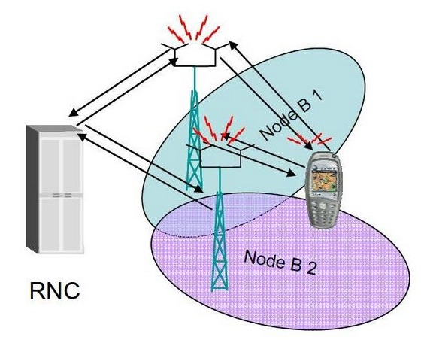
MECHANISM OF SOFT HANDOVER
The call is first connected to the new base station BS₂ and then it is dropped by the previous base station BS₁.
The call will be established only when a reliable connection to the target cell is obtained. The MS is linked to two BS for a brief interval of time. Thus soft handover involves connection to more than one cell.
Radio Network Controller
controlling the BS
Notes:
The Radio Network Controller (or RNC) is a governing element in the UMTS radio access network (UTRAN) and is responsible for controlling the Node Bs that are connected to it. The RNC carries out radio resource management, some of the mobility management functions and is the point where encryption is done before user data is sent to and from the mobile. The RNC connects to the Circuit Switched Core Network through Media Gateway (MGW) and to the SGSN (Serving GPRS Support Node) in the Packet Switched Core Network.

Slide 19
CHARACTERISTICS
It offers more reliable access continuity in network connection and less chances of a call termination during switching of base stations in comparison to a Hard handoff.
It is commonly used in CDMA (Code-division multiple access) systems that enables the overlapping of the repeater coverage zones, so that every cell phone set is always well within range of at least one of the base stations.
Technical implementation of a Soft handoff is more expensive and complex in comparison to a Hard handoff.
It is used in sensitive communication services such as videoconferencing.

Slide 20
Cell Sectoring by Antenna Design
c
c
120º
120º
a
b
a
b
(a). Omni
(b). 120º sector
(c). 120º sector (alternate)
d
f
90º
e
60º
a
a
c
d
b
b
c
(d). 90º sector
(e). 60º sector

Slide 21
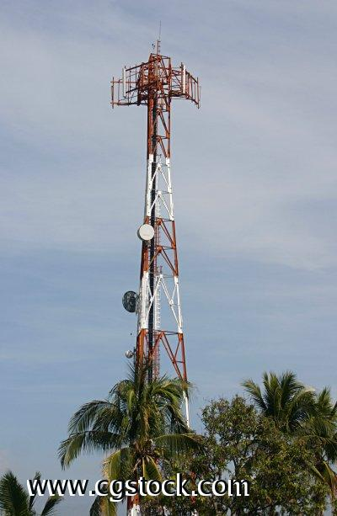
Sectorized Antennas
Further interference reduction by using sectorized antennas.

Slide 22
Cell Sectoring by Antenna Design
Placing directional transmitters at corners where three
adjacent cells meet
B
C
X
A

Slide 23
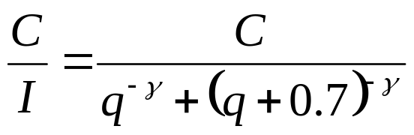

Worst Case for Forward Channel Interference in Three-sectors
BS
D + 0.7R
BS
MS
R
BS
D
BS

Slide 24
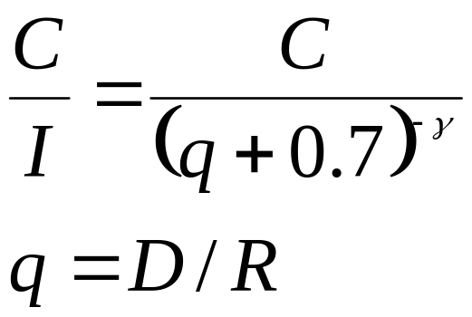
Worst Case for Forward Channel Interference in Six-sectors
MS
BS
R
D +0.7R
BS

Slide 25
Cell Splitting
Often large cells need to be split into smaller ones because the population of users in the big cell has increased beyond what it can support
  Cell splitting increases system capacity
  Is used in high density subscriber areas (eg. Water Front)
  Results to increased costs (eg. new base stations)
  Difficult to maintain coverage boundary

Slide 26
Cell Splitting
2
1
2
3
2
1
3
7
1
3
7
6
4
6
4
7
5
5
6
4
5

Slide 27
Cell Splitting
Large cell (low density)
Small cell (high density)
Smaller cell (higher density)
Depending on traffic patterns the smaller cells may be activated/deactivated in order to efficiently use cell resources.

Slide 28
Frequency Planning

Slide 29

Frequency Planning
Mobile cellular communication is a full duplex system where the entire allocated bandwidth of a service provider is divided into two equal halves: one half is for uplink channels and the other half for down link channels. A guard band of 45MHz is maintained between up and down link channel of a particular call to avoid interference.

Slide 30
AMPS has two different band named Band-A and band-B, each has 12.5 MHz band of frequency (10MHz is called non-expanded spectrum and 2.5 MHz is the expanded spectrum). Channel spacing in AMPS is 30 KHz therefore total 12.5 MHz/30KHz = 416 channels are available for each band among them 21 channels are used as control channel and the remaining 395 for voice call.
Notes:
AMPS (Advanced Mobile Phone System)

Slide 31
Band A Frequency for 7/21 pattern
1A | 2A | 3A | 4A | 5A | 6A | 7A | 1B | 2B | 3B | 4B | 5B | 6B | 7B | 1C | 2C | 3C | 4C | 5C | 6C | 7C
1 | 2 | 3 | 4 | 5 | 6 | 7 | 8 | 9 | 10 | 11 | 12 | 13 | 14 | 15 | 16 | 17 | 18 | 19 | 20 | 21
22 | 23 | 24 | 25 | 26 | 27 | 28 | 29 | 30 | 31 | 32 | 33 | 34 | 35 | 36 | 37 | 38 | 39 | 40 | 41 | 42
43 | 44 | 45 | 46 | 47 | 48 | 49 | 50 | 51 | 52 | 53 | 54 | 55 | 56 | 57 | 58 | 59 | 60 | 61 | 62 | 63
64 | 65 | 66 | 67 | 68 | 69 | 70 | 71 | 72 | 73 | 74 | 75 | 76 | 77 | 78 | 79 | 80 | 81 | 82 | 83 | 84
85 | 86 | 87 | 88 | 89 | 90 | 91 | 92 | 93 | 94 | 95 | 96 | 97 | 98 | 99 | 100 | 101 | 102 | 103 | 104 | 105
106 | 107 | 108 | 109 | 110 | 111 | 112 | 113 | 114 | 115 | 116 | 117 | 118 | 119 | 120 | 121 | 122 | 123 | 124 | 125 | 126
127 | 128 | 129 | 130 | 131 | 132 | 133 | 134 | 135 | 136 | 137 | 138 | 139 | 140 | 141 | 142 | 143 | 144 | 145 | 146 | 147
148 | 149 | 150 | 151 | 152 | 153 | 154 | 155 | 156 | 157 | 158 | 159 | 160 | 161 | 162 | 163 | 164 | 165 | 166 | 167 | 168
169 | 170 | 171 | 172 | 173 | 174 | 175 | 176 | 177 | 178 | 179 | 180 | 181 | 182 | 183 | 184 | 185 | 186 | 187 | 188 | 189
190 | 191 | 192 | 193 | 194 | 195 | 196 | 197 | 198 | 199 | 200 | 201 | 202 | 203 | 204 | 205 | 206 | 207 | 208 | 209 | 210
211 | 212 | 213 | 214 | 215 | 216 | 217 | 218 | 219 | 220 | 221 | 222 | 223 | 224 | 225 | 226 | 227 | 228 | 229 | 230 | 231
232 | 233 | 234 | 235 | 236 | 237 | 238 | 239 | 240 | 241 | 242 | 243 | 244 | 245 | 246 | 247 | 248 | 249 | 250 | 251 | 252
253 | 254 | 255 | 256 | 257 | 258 | 259 | 260 | 261 | 262 | 263 | 264 | 265 | 266 | 267 | 268 | 269 | 270 | 271 | 272 | 273
274 | 275 | 276 | 277 | 278 | 279 | 280 | 281 | 282 | 283 | 284 | 285 | 286 | 287 | 288 | 289 | 290 | 291 | 292 | 293 | 294
295 | 296 | 297 | 298 | 299 | 300 | 301 | 302 | 303 | 304 | 305 | 306 | 307 | 308 | 309 | 310 | 311 | 312
313 | 314 | 315 | 316 | 317 | 318 | 319 | 320 | 321 | 322 | 323 | 324 | 325 | 326 | 327 | 328 | 329 | 330 | 331 | 332 | 333
 |  |  |  |  |  |  |  |  |  |  |  |  |  |  | 667 | 668 | 669 | 670 | 671 | 672
673 | 674 | 675 | 676 | 677 | 678 | 679 | 680 | 681 | 682 | 683 | 684 | 685 | 686 | 687 | 688 | 689 | 690 | 691 | 692 | 693
694 | 695 | 696 | 697 | 698 | 699 | 700 | 701 | 702 | 703 | 704 | 705 | 706 | 707 | 708 | 709 | 710 | 711 | 712 | 713 | 714
715 | 716
 |  |  |  |  |  |  |  |  | 991 | 992 | 993 | 994 | 995 | 996 | 997 | 998 | 999 | 1000 | 1001 | 1002
1003 | 1004 | 1005 | 1006 | 1007 | 1008 | 1009 | 1010 | 1011 | 1012 | 1013 | 1014 | 1015 | 1016 | 1017 | 1018 | 1019 | 1020 | 1021 | 1022 | 1023

Slide 32
Band B Frequency for 7/21 pattern
1A | 2A | 3A | 4A | 5A | 6A | 7A | 1B | 2B | 3B | 4B | 5B | 6B | 7B | 1C | 2C | 3C | 4C | 5C | 6C | 7C
334 | 335 | 336 | 337 | 338 | 339 | 340 | 341 | 342 | 343 | 344 | 345 | 346 | 347 | 348 | 349 | 350 | 351 | 352 | 353 | 354
355 | 356 | 357 | 358 | 359 | 360 | 361 | 362 | 363 | 364 | 365 | 366 | 367 | 368 | 369 | 370 | 371 | 372 | 373 | 374 | 375
376 | 377 | 378 | 379 | 380 | 381 | 382 | 383 | 384 | 385 | 386 | 387 | 388 | 389 | 390 | 391 | 392 | 393 | 394 | 395 | 396
397 | 398 | 399 | 400 | 401 | 402 | 403 | 404 | 405 | 406 | 407 | 408 | 409 | 410 | 411 | 412 | 413 | 414 | 415 | 416 | 417
418 | 419 | 420 | 421 | 422 | 423 | 424 | 425 | 426 | 427 | 428 | 429 | 430 | 431 | 432 | 433 | 434 | 435 | 436 | 437 | 438
439 | 440 | 441 | 442 | 443 | 444 | 445 | 446 | 447 | 448 | 449 | 450 | 451 | 452 | 453 | 454 | 455 | 456 | 457 | 458 | 459
460 | 461 | 462 | 463 | 464 | 465 | 466 | 467 | 468 | 469 | 470 | 471 | 472 | 473 | 474 | 475 | 476 | 477 | 478 | 479 | 480
481 | 482 | 483 | 484 | 485 | 486 | 487 | 488 | 489 | 490 | 491 | 492 | 493 | 494 | 495 | 496 | 497 | 498 | 499 | 500 | 501
502 | 503 | 504 | 505 | 506 | 507 | 508 | 509 | 510 | 511 | 512 | 513 | 514 | 515 | 516 | 517 | 518 | 519 | 520 | 521 | 522
523 | 524 | 525 | 526 | 527 | 528 | 529 | 530 | 531 | 532 | 533 | 534 | 535 | 536 | 537 | 538 | 539 | 540 | 541 | 542 | 543
544 | 545 | 546 | 547 | 548 | 549 | 550 | 551 | 552 | 553 | 554 | 555 | 556 | 557 | 558 | 559 | 560 | 561 | 562 | 563 | 564
565 | 566 | 567 | 568 | 569 | 570 | 571 | 572 | 573 | 574 | 575 | 576 | 577 | 578 | 579 | 580 | 581 | 582 | 583 | 584 | 585
586 | 587 | 588 | 589 | 590 | 591 | 592 | 593 | 594 | 595 | 596 | 597 | 598 | 599 | 600 | 601 | 602 | 603 | 604 | 605 | 606
607 | 608 | 609 | 610 | 611 | 612 | 613 | 614 | 615 | 616 | 617 | 618 | 619 | 620 | 621 | 622 | 623 | 624 | 625 | 626 | 627
628 | 629 | 630 | 631 | 632 | 633 | 634 | 635 | 636 | 637 | 638 | 639 | 640 | 641 | 642 | 643 | 644 | 645 | 646 | 647 | 648
649 | 650 | 651 | 652 | 653 | 654 | 655 | 656 | 657 | 658 | 659 | 660 | 661 | 662 | 663 | 664 | 665 | 666
 |  |  |  |  | 717 | 718 | 719 | 720 | 721 | 722 | 723 | 724 | 725 | 726 | 727 | 728 | 729 | 730 | 731 | 732
733 | 734 | 735 | 736 | 737 | 738 | 739 | 740 | 741 | 742 | 743 | 744 | 745 | 746 | 747 | 748 | 749 | 750 | 751 | 752 | 753
754 | 755 | 756 | 757 | 758 | 759 | 760 | 761 | 762 | 763 | 764 | 765 | 766 | 767 | 768 | 769 | 770 | 771 | 772 | 773 | 774
775 | 776 | 777 | 778 | 779 | 780 | 781 | 782 | 783 | 784 | 785 | 786 | 787 | 788 | 789 | 790 | 791 | 792 | 793 | 794 | 795
796 | 797 | 798 | 799

Slide 33
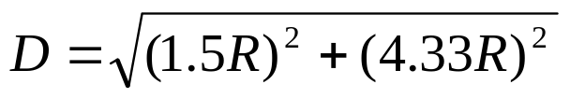


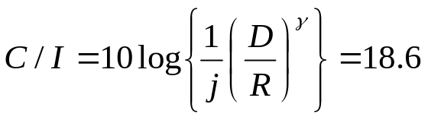
N=7 cell pattern
In N=7 cell cluster of omni three frequency groups of table 2 or 3 is used per cell following the sequence (N, N+7,N+14) where N is the cell number. The channel isolation within a cell is 7×30KHz=210KHz. The channel isolation of adjacent cell is 30KHz between cell 1 and 2 and that of 1 and 3 is 60KHz etc.The separation between adjacent cell,
3
3,10,17
1.5R
4.33R
6
6,13,20
5
5,12,19
3
3,10,17
1
1,8,15
6
6,13,20
5
5,12,19
4
4,11,18
7
7,14,21
1
1,8,15
2
2,9,16
4
4,11,18
7
7,14,21
3
3,10,17
2
2,9,16
6
6,13,20
5
5,12,19
dB
1
1,8,15
4
4,11,18
7
7,14,21
; taking number of co-channel interference j=6, propagation constant γ=4
2
2,9,16
Notes:
Root of 3 *R

Slide 34
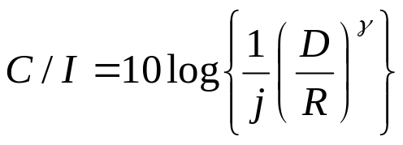
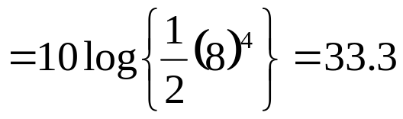
Sometimes cell cluster is formed arranging the cells in two rows like fig.2 having alternate channel assignments known as trapezoidal plan. Here the minimum separation between adjacent channel cells is 2×30=60KHz; better than the previous one.
dB
1
1,8,15
5
5,12,19
2
2,9,16
6
6,13,20
≈8R
1.5R
3
3,10,17
7
7,14,21
4
4,11,18
1
1,8,15
5
5,12,19
2
2,9,16
6
6,13,20
1
1,8,15
5
5,12,19
2
2,9,16
6
6,13,20
3
3,10,17
7
7,14,21
4
4,11,18
3
3,10,17
7
7,14,21
4
4,11,18
1
1,8,15
5
5,12,19
2
2,9,16
6
6,13,20
3
3,10,17
7
7,14,21
4
4,11,18
≈8.1R

Slide 35
N=9 Omni Frequency Plan
Here the available channels are divided into 9 or multiples of 9 groups like table-2
Table-2
1 | 2 | 3 | 4 | 5 | 6 | 7 | 8 | 9 | 10 | 11 | 12 | 13 | 14 | 15 | 16 | 17 | 18
19 | 20 | 21 | 22 | 23 | 24 | 25 | 26 | 27 | 28 | 29 | 30 | 31 | 32 | 33 | 34 | 35 | 36
37 | 38 | 39 | 40 | 41 | 42 | 43 | 44 | 45 | 46 | 47 | 48 | 49 | 50 | 51 | 52 | 53 | 54
55 | 56 | 57 | 58 | 59 | 60 | 61 | 62 | 63 | 64 | 65 | 66 | 67 | 68 | 69 | 70 | 71 | 72
73 | 74 | 75 | 76 | 77 | 78 | 79 | 80 | 81 | 82 | 83 | 84 | 85 | 86 | 87 | 88 | 89 | 90
91 | 92 | 93 | 94 | 95 | 96 | 97 | 98 | 99 | 100 | 101 | 102 | 103 | 104 | 105 | 106 | 107 | 108
109 | 110 | 111 | 112 | 113 | 114 | 115 | 116 | 117 | 118 | 119 | 120 | 121 | 122 | 123 | 124 | 125 | 126
127 | 128 | 129 | 130 | 131 | 132 | 133 | 134 | 135 | 136 | 137 | 138 | 139 | 140 | 141 | 142 | 143 | 144
145 | 146 | 147 | 148 | 149 | 150 | 151 | 152 | 153 | 154 | 155 | 156 | 157 | 158 | 159 | 160 | 161 | 162

Slide 36
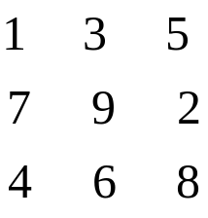
The cell is in the form of array like fig.4. In this scheme there is no adjacent channels within the cell cluster like N=7 cells pattern. Because of rhombic pattern only vertical and horizontal expansion is possible like fig.5
The array is,
1
3
5
7
9
2
1
3
5
4
6
8
1
3
5
7
9
2
7
9
2
4
6
8
4
6
8
1
3
5
1
3
5
7
9
2
7
9
2
4
6
8
4
6
8

Slide 37
120-Deg Sectorization
In this scheme a cell is divided into three sectors of 120 deg each like fig.1 where each sector is treated as a logical OMNI cell. Three directional antennas are used at the center of the cell with 120 deg apart to illuminate each sector. Fig.2. shows an alternate representation known as the tricellular plan. Each sector contains one control channel and several voice channels. Adequate channel isolation is necessary within and between sectors to avoid co-site and adjacent channel interference.
Sector-1
Sector-2
Sector-2
Sector-1
Sector-3
Sector-3
(a) Conventional representation (b) Alternate representation

Slide 38
In N=7/21 cluster each cell of N=7 OMNI cluster is divided into three sectors and one frequency group per sector is allocated based on (N, N+7, N+14) distribution where N=1,2,3, …, 7 are the number of cells. For example for N=3, (3, 10, 17) i.e. frequency group 3 for sector 1, frequency group 10 for sector 2 and frequency group 17 for sector 3 of third cell.
1
8
6
6
6
13
3
3
10
1
8
15
1
8
4
3
20
17
15
1
8
15
4
4
11
1
1
8
5
5
12
1
1
8
15
1
8
18
15
19
2
5
15
1
8
15
2
2
9
7
7
14
7
16
21
15
(b) N=7/21 traicellular plan
Fig.1 (a) N=7/21 sectored configuration

Slide 39
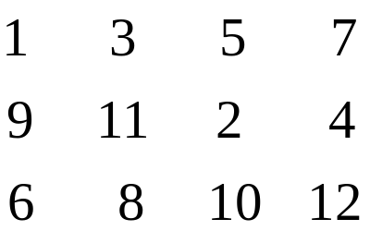
N=4/24 Tricellular Plan
In N=4 tricellular plan there are 4 traicells and 12 logical cells/sectors. Here channel assignment is based on 4×3 array, requires 12 or multiple of 12 frequency groups like fig.1.
1
3
5
7
9
11
2
4
6
8
10
12
Fig. N=4 tricellular plan
For 24 frequency groups of table-2 can be distributed among 12 logical cells/sectors using the form, N+12; where N=1, 2, 3 ,…, 12.

Slide 40
Logical cell 1: Frequency groups: (1, 13)
Logical cell 2: Frequency groups: (2, 14)
Logical cell 3: Frequency groups: (3, 15)
………………………………………….
………………………………………….
………………………………………….
Logical cell 12: Frequency groups: (12, 24)
The growth plan is based on repeating the 4×3 array vertically and horizontally like fig.4

Slide 41
1
3
5
7
1
3
5
7
9
11
2
4
9
11
2
4
6
8
10
12
6
8
10
12
1
3
5
7
1
3
5
7
9
11
2
4
9
11
2
4
6
8
10
12
6
8
10
12
Fig. The N=4 tricellular growth

Slide 42
N=4/24 Band A Frequency Chart
1 | 2 | 3 | 4 | 5 | 6 | 7 | 8 | 9 | 10 | 11 | 12 | 13 | 14 | 15 | 16 | 17 | 18 | 19 | 20 | 21 | 22 | 23 | 24
25 | 26 | 27 | 28 | 29 | 30 | 31 | 32 | 33 | 34 | 35 | 36 | 37 | 38 | 39 | 40 | 41 | 42 | 43 | 44 | 45 | 46 | 47 | 48
49 | 50 | 51 | 52 | 53 | 54 | 55 | 56 | 57 | 58 | 59 | 60 | 61 | 62 | 63 | 64 | 65 | 66 | 67 | 68 | 69 | 70 | 71 | 72
73 | 74 | 75 | 76 | 77 | 78 | 79 | 80 | 81 | 82 | 83 | 84 | 85 | 86 | 87 | 88 | 89 | 90 | 91 | 92 | 93 | 94 | 95 | 96
97 | 98 | 99 | 100 | 101 | 102 | 103 | 104 | 105 | 106 | 107 | 108 | 109 | 110 | 111 | 112 | 113 | 114 | 115 | 116 | 117 | 118 | 119 | 120
121 | 122 | 123 | 124 | 125 | 126 | 127 | 128 | 129 | 130 | 131 | 132 | 133 | 134 | 135 | 136 | 137 | 138 | 139 | 140 | 141 | 142 | 143 | 144
145 | 146 | 147 | 148 | 149 | 150 | 151 | 152 | 153 | 154 | 155 | 156 | 157 | 158 | 159 | 160 | 161 | 162 | 163 | 164 | 165 | 166 | 167 | 168
169 | 170 | 171 | 172 | 173 | 174 | 175 | 176 | 177 | 178 | 179 | 180 | 181 | 182 | 183 | 184 | 185 | 186 | 187 | 188 | 189 | 190 | 191 | 192
193 | 194 | 195 | 196 | 197 | 198 | 199 | 200 | 201 | 202 | 203 | 204 | 205 | 206 | 207 | 208 | 209 | 210 | 211 | 212 | 213 | 214 | 215 | 216
217 | 218 | 219 | 220 | 221 | 222 | 223 | 224 | 225 | 226 | 227 | 228 | 229 | 230 | 231 | 232 | 233 | 234 | 235 | 236 | 237 | 238 | 239 | 240

Slide 43
Cyclic Distribution of Channels:
Here channel distribution is based on (N, N+4, N+8) where cell number N=1, 2,3 4. The cell cluster consists of four tricells and 12 logical cells/sectors. If cell 1 is assumed to be in the center, the surrounding pattern will be 2, 3, 4, 2, 3, 4. Similarly if cell 2 is in the center the surrounding pattern will be 1, 3, 4,1 ,3, 4. Likewise if cell 3 is in the center the surrounding pattern will be 1, 2, 4,1 ,2, 4 and if cell 4 is in the center the surrounding pattern will be 1, 2, 3,1 ,2, 3
5
9
1
8
12
1
6
10
4
2
4
7
11
2
3
3
Fig.3 N=4 tricellular pattern

Slide 44
3
2
2
4
1
4
1
3
4
Case-1
2
4
Case-3
1
3
2
3
2
1
4
1
3
4
2
4
3
Case-4
1
1
Case-2
3
2
Fig.5 Growth of N=4 tricellular plan when cell i = 1, 2,3 , 4 is in the center

Slide 45
7
11
3
6
10
3
8
12
2
4
2
5
9
4
1
8
12
1
6
10
4
2
4
7
11
2
3
3
Fig.5 Growth of N=4 tricellular plan when cell 1 is in the center

Slide 46
N=4/24, 60 deg Sectored Plan
Here a cell is divided into six sectors of 60 deg each shown in fig.1 where each sector is treated as a logical cell. Sine narrow cell is used therefore a cell can be repeated more often hence capacity of the network is enhanced. This type of cell sectoring technique is suitable for urban area.
In N=4/24, 60 deg sectored plan, the available channels are divided into 24 frequency groups, distributed evenly among four 60 deg sectors, one frequency group per sector. Heavilty directional antennas are used in each sector to ensure adequate channel isolation between sectors and better adjacent channel C/I performance throughout the network. Channel assignment is based on the following sequence (N, N+4, N+8, N+12, N+16, N+20) where N is the cell number (N+1, 2, 3 and 4 )

Slide 47
21
1
17
1
5
13
9
24
4
22
2
21
1
20
4
8
18
2
6
17
1
5
16
12
14
10
13
9
23
3
24
4
22
2
19
3
7
20
4
8
18
2
6
Sector-1
15
11
16
12
14
10
Sector-6
Sector-2
23
3
Sector-5
Sector-3
19
3
7
Sector-4
15
11
Fig.1 N=4/24 cell pattern

Slide 48
Thank You

Slide 49
HANDOFF DECISIONS
There are numerous methods for performing handoff. From the decision process point of view, one can find at least three different kinds of handoff decisions.
Network-Controlled Handoff
Mobile-Assisted Handoff
Mobile-Controlled Handoff

Slide 50
Network-Controlled Handoff
In a network-controlled handoff protocol, the network makes a handoff decision based on the measurements of the MSs at a number of BSs.
In general, the handoff process takes 100–200 ms.
Network-controlled handoff is used in first-generation analog systems such as AMPS (Advanced Mobile Phone System), TACS(Total Access Communication System), and NMT (Nordic Mobile Telephone).
Mobile-Assisted Handoff
In a mobile-assisted handoff process, the MS makes measurements and the network makes the decision.
In the circuit-switched GSM (global system mobile), the BS controller (BSC) is in charge of the radio interface management. This mainly means allocation and release of radio channels and handoff management.
The handoff time between handoff decision and execution in a circuit-switched GSM is approximately 1 second.

Slide 51
Mobile-Controlled Handoff
In mobile-controlled handoff, each MS is completely in control of the handoff process.
This type of handoff has a short reaction time (in the order of 0.1 second).
MS measures the signal strengths from surrounding BSs and interference levels on all channels.
A handoff can be initiated if the signal strength of the serving BS is lower than that of another BS by a certain threshold.

Slide 52
HANDOFF FAILURES
Because frequencies cannot be reused in adjacent cells, when a user moves from one cell to another, a new frequency must be allocated for the call.
If a user moves into a cell when all available channels are in use, the user’s call must be terminated.
Problem of signal interference where adjacent cells overpower each other resulting in receiver desensitization is also there.

Slide 53


Slide 54
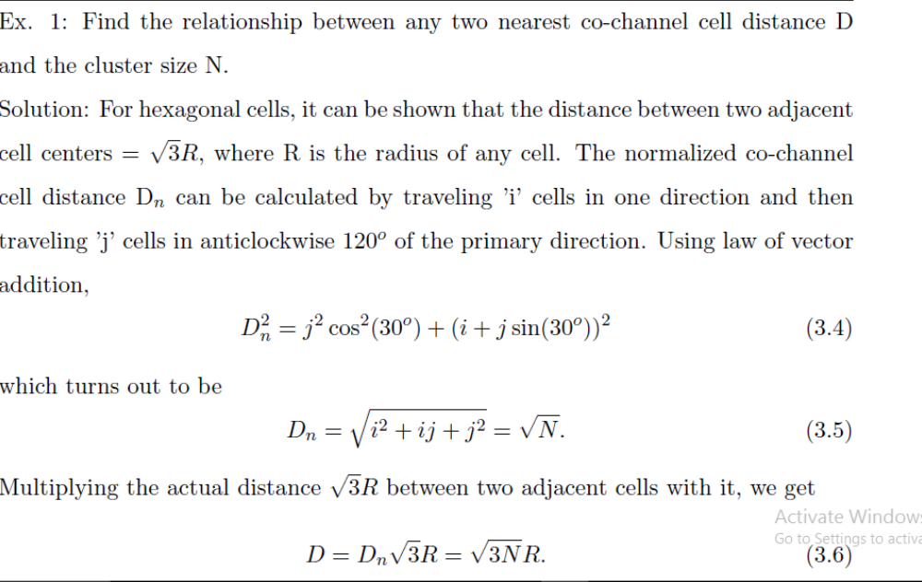

Slide 55
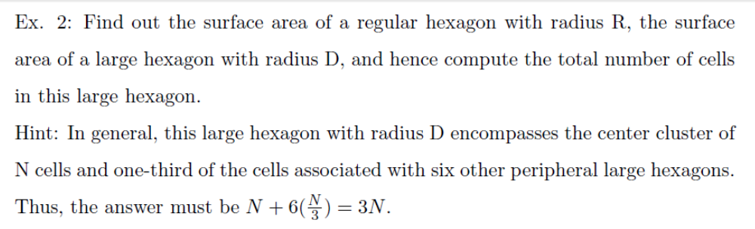

Slide 56
